Slide 1
MENTAL HEALTH CHATBOT
Tausif Khan, Varun Jain, Allen Mathews

Slide 2
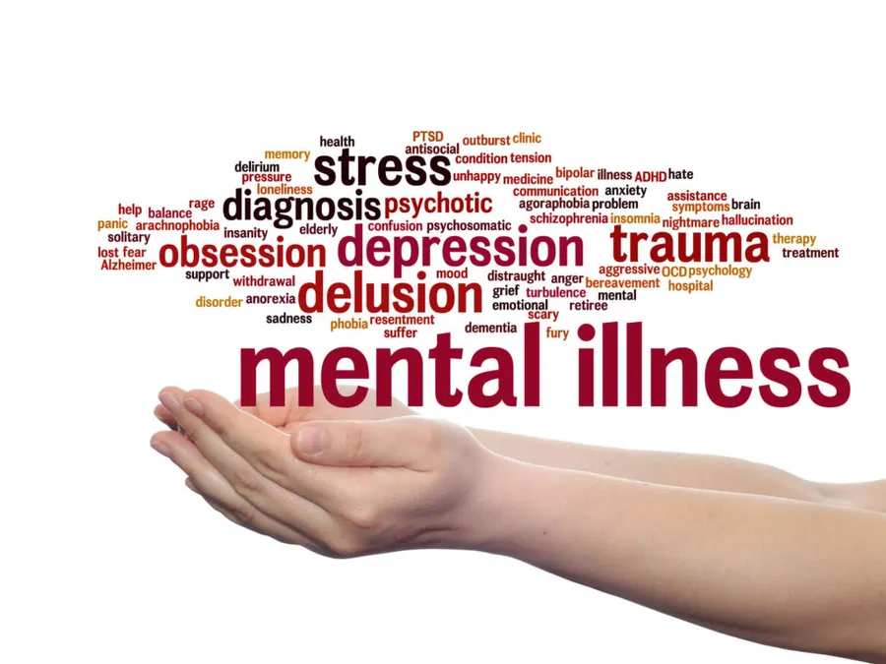
Problem Statement
Rising demand for mental health as it is a critical issue that affects everyone worldwide
Shortage of mental health professionals and resources plus a lack of accessibility of services due to costs and availability
Underdiagnosis and undertreatment of mental health disorders in certain demographic groups such as minorities and low-income populations
Require innovative approaches that can overcome accessibility issues

Slide 3
Motivation
Potential benefits of technology driven solutions to overcome barriers of accessible mental health
Can provide a scalable solution to multiple people simultaneously
Can offer immediate support and guidance to individuals, helping them with emotions and connect with appropriate resources if needed
Provides anonymity for individuals to express themselves without fear of judgement

Slide 4
Data Source
Mental Health Counseling Conversations
Collection of questions and answers sourced from two online counseling and therapy platforms, 3512 observations in dataset
Covers a wide range of mental health topics, and the answers are provided by qualified psychologists
No additional annotations, tags, or labels from raw data
Contains sensitive information related to mental health. Data is anonymous and has no personal info

Slide 5
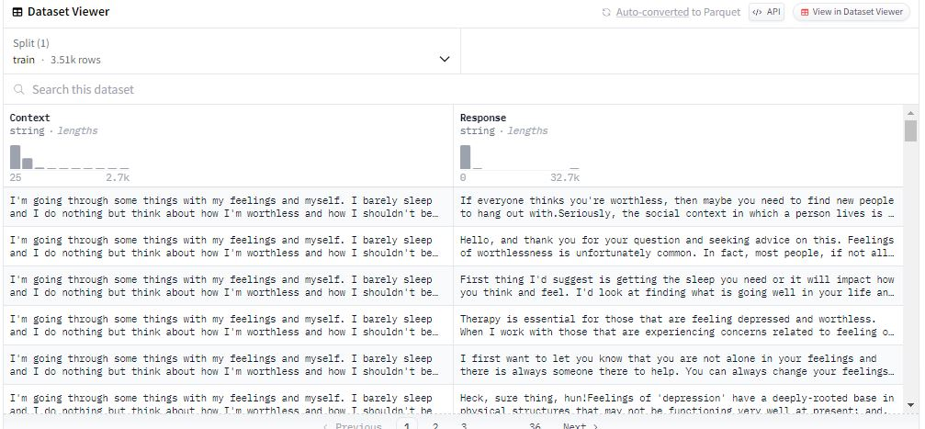
Data Source

Slide 6
Data Preprocessing
Preprocess data: expanding contractions, lowercasing, and removing punctuation
Tokenization
Removing stop words
Lemmatization

Slide 7
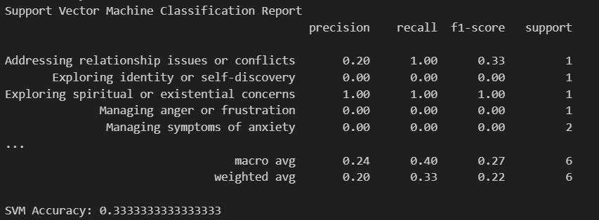
Intention Classification and Analysis
Labeled a small sample of data points with intent (context).
Some labels include ‘Coping with depression or sadness’, ‘Managing social phobia’, ‘Managing symptoms of anxiety’, etc.
Input data is vectorized using TF-IDF
Different algorithms are applied on these input vectors to label the remaining points based on the intents assigned above

Slide 8
Seq2Seq - Sequence to Sequence
Primarily used to convert sequences of one type into another.
Our code used basic Seq2seq model implementation using Pytorch for training a neural network on our dataset.
We have used GPT2-tokenizer to transform the sentences into tokens and then passing it through out neural network.
Collate the data points and feed it to the neural network.
Pass the inputs and expected outputs through the model. The model’s forward pass helps understand the context and helps the model decode the output.
Then we trained over 5 epochs which helped decrease the loss function with every iteration.

Slide 9
LSTM (Long Short-Term Memory)
Used to capture long-term dependencies in sequential data.
The input data is tokenized and padded before training the LSTM model.
Word2Vec embeddings are generated for the input data.
It captures semantic relationships between words and provides context.
These embeddings serve as the input for the model.
Model consists of multiple LSTM layers, for additional complexity a dense layer for classification.
Trained over 10 epochs to capture complex patterns within the data.

Slide 10
Evaluation
Sample input 1: “I’m going through some things, I cannot sleep at night. How do i change my feeling”
Predicted output: always always influence belief inspiration change
Sample input 2: “Need help”
Predicted output: common common

Slide 11
Limitations
LSTM and Seq2seq are both reliant on large datasets for effective datasets, which could impact performance on limited dataset.
Issues such as out-of-vocabulary words, lack of semantic understanding leads to significant challenges in NLP tasks.
Generating sequences in seq2seq is done using tokens, this makes the task slower for long sentences.
Due to limited computational power, we had to use a dataset with less data points which caused a reduction in our accuracy.

Slide 12
Conclusion
We should be aware of the limitations in time, resources and challenges that come with working in this domain
With enough time and resources, we can hope to fine-tune the implemented RNN models to improve their ability to provide more substantial outputs
Personalized responses can enhance effectiveness in supporting the user’s mental well being

Slide 13
Future Directions
Collect and use a dataset with more data points to work toward an improved performance of the system.
Explore and integrate more advanced neural networks and algorithms to improve response generation and better understand/personalize interactions based on user history
Improve algorithms to reduce bias and ensure fair treatment regardless of background
Notes:
Looking ahead, there are several key areas we plan to focus on to enhance our mental health chatbot. Firstly, we aim to collect and use a dataset with more data points. Increasing the size and diversity of our dataset will provide the model with more examples to learn from, helping to improve its overall performance and robustness. A larger dataset will also allow us to capture a wider range of conversational nuances and mental health topics.
Secondly, we plan to explore and integrate more advanced neural networks and algorithms. By leveraging state-of-the-art techniques such as transformer models (e.g., BERT, GPT) and more sophisticated neural network architectures, we can significantly improve response generation. Additionally, advanced algorithms will help us better understand user interactions and personalize responses based on user history, leading to a more tailored and effective user experience.
Thirdly, we are committed to improving our algorithms to reduce bias and ensure fair treatment. It's crucial that our chatbot provides equitable support to all users, regardless of their background. We will focus on implementing techniques to identify and mitigate biases in our training data and models, ensuring that our system treats all users fairly and respectfully.
In summary, by expanding our dataset, adopting advanced technologies, and prioritizing fairness, we aim to continually enhance the capabilities and effectiveness of our mental health chatbot. These future directions will help us provide better support to users and make a meaningful impact on their mental well-being.

